Slide 1
“走出去”之——突破你生命的界限 徒11：19-30

Slide 2
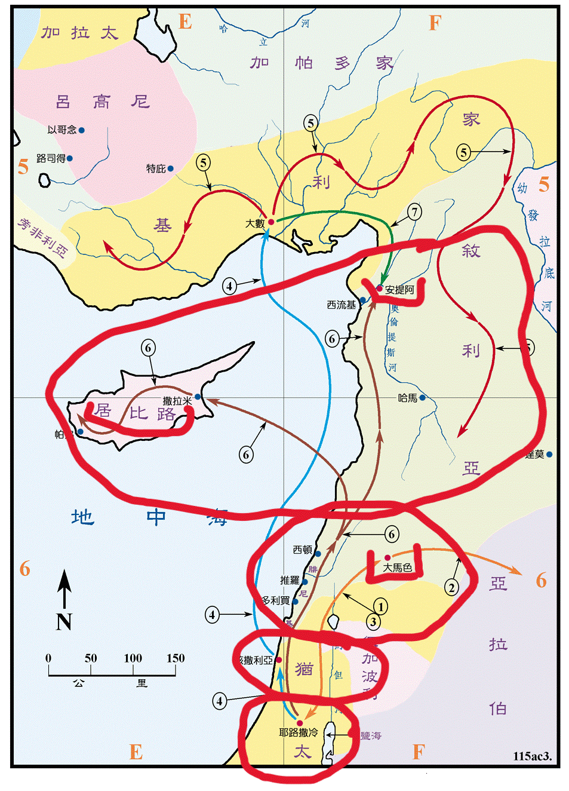

Slide 3
祈祷/Prayer

Slide 4
一、突破生命的界限——安提阿教会的建立 徒11：19 那些因司提反的事遭患难四散的门徒，直走到腓尼基，和塞浦路斯，并安提阿。他们不向别人讲道，只向犹太人讲。20 但内中有居比路，和古利奈人，他们到了安提阿，也向希利尼人传讲主耶稣。 Acts 11:19 Now those who had been scattered by the persecution that broke out when Stephen was killed travelled as far as Phoenicia, Cyprus and Antioch, spreading the word only among Jews. 20 Some of them, however, men from Cyprus and Cyrene, went to Antioch and began to speak to Greeks also, telling them the good news about the Lord Jesus.

Slide 5
9……彼得约在午正，上房顶去祷告。10觉得饿了，想要吃。那家的人正预备饭的时候，彼得魂游象外。11看见天开了，有一物降下，好像一块大布。系着四角，缒在地上。12里面有地上各样四足的走兽，和昆虫，并天上的飞鸟。13又有声音向他说，彼得起来，宰了吃。14彼得却说，主阿，这是不可的，凡俗物，和不洁净的物，我从来没有吃过。15第二次有声音向他说，神所洁净的，你不可当作俗物。16这样一连三次，那物随即收回天上去了。 徒/Acts 10:9-16

Slide 6
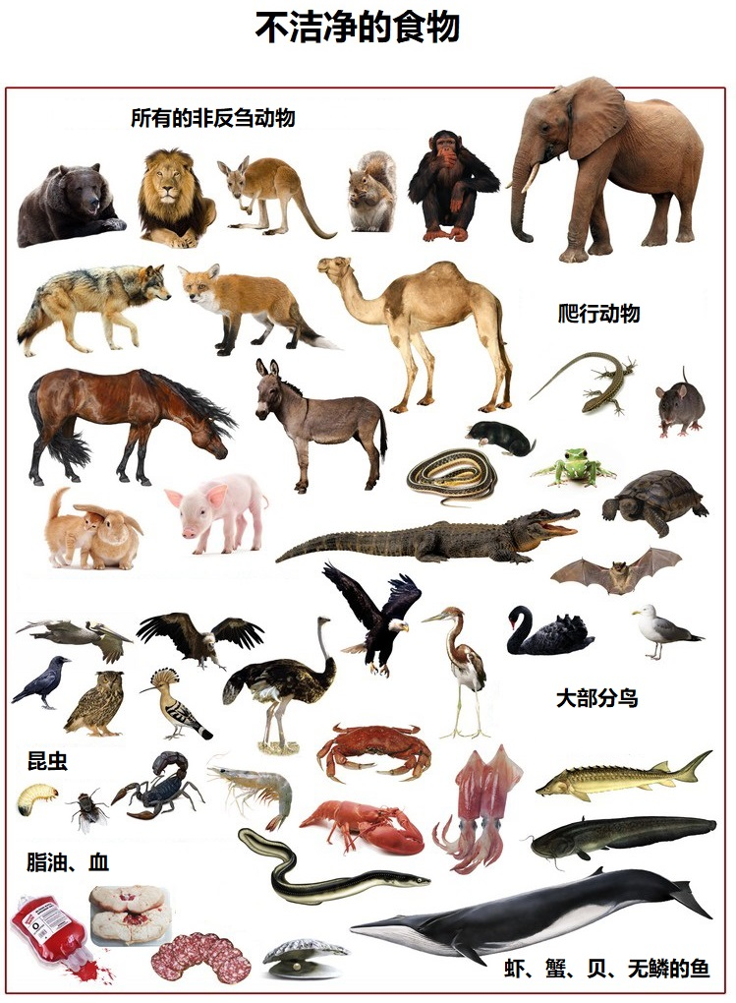

Slide 7
10:27彼得和他说着话进去，见有好些人在那里聚集，28就对他们说，你们知道犹太人，和别国的人亲近来往，本是不合例的。但神已经指示我，无论什么人，都不可看作俗而不洁净的。 27While talking with him, Peter went inside and found a large gathering of people. 28He said to them: ‘You are well aware that it is against our law for a Jew to associate with or visit a Gentile. But God has shown me that I should not call anyone impure or unclean.

Slide 8
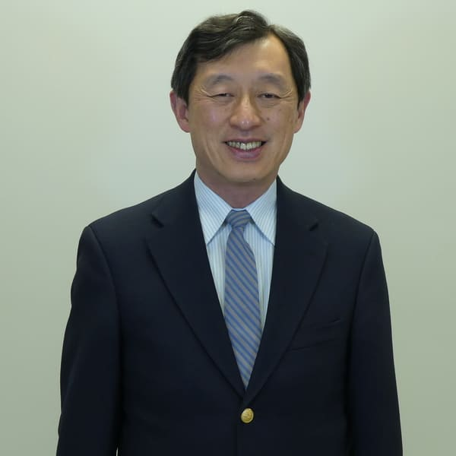
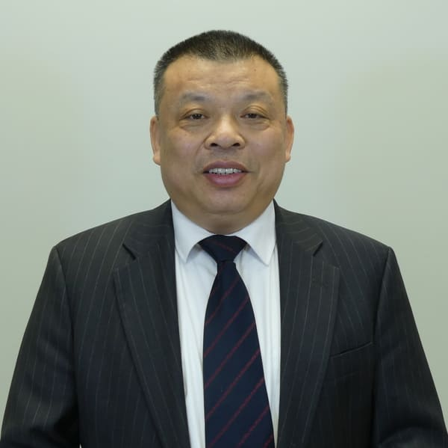
芝华宣道总干事：林恒志牧师
跨文华事工主任：黄多赐牧师

Slide 9
19……他们不向别人讲道，只向犹太人讲。20 但内中有居比路，和古利奈人，他们到了安提阿，也向希利尼人传讲主耶稣。 19…spreading the word only among Jews. 20 Some of them, however, men from Cyprus and Cyrene, went to Antioch and began to speak to Greeks also, telling them the good news about the Lord Jesus.

Slide 10
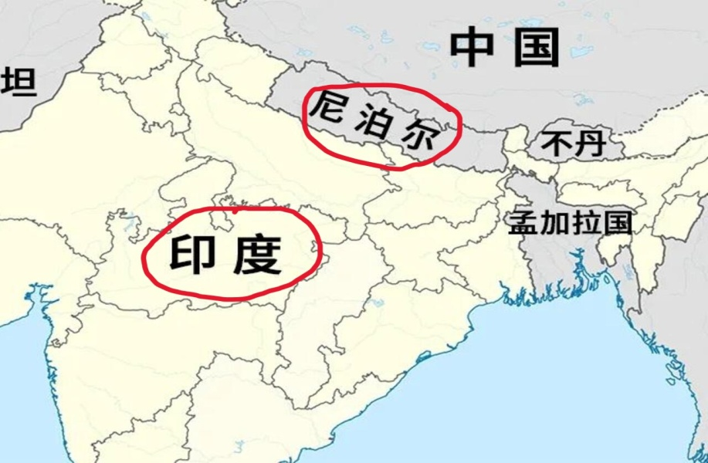
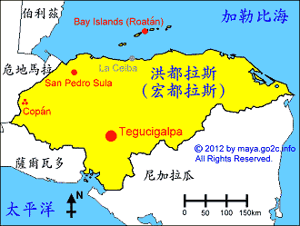
印度和尼泊尔网宣 6月14-18日 7月12-16日
洪都拉斯短宣 8月份

Slide 11
二、突破生命界限的例子——神的仆人巴拿巴 21主与他们同在，信而归主的人就很多了。22这风声传到耶路撒冷教会人的耳中，他们就打发巴拿巴出去，走到安提阿为止。 21The Lord’s hand was with them, and a great number of people believed and turned to the Lord. 22 News of this reached the church in Jerusalem, and they sent Barnabas to Antioch.

Slide 12
徒6：3 弟兄们，当从你们中间选出七个有好名声、被圣灵充满、智慧充足的人，我们就派他们管理这事 Acts 6:3 Brothers and sisters, choose seven men from among you who are known to be full of the Spirit and wisdom. We will turn this responsibility over to them

Slide 13
徒9：26扫罗到了耶路撒冷，想与门徒结交。他们却都怕他，不信他是门徒。 Acts 9:26 When he came to Jerusalem, he tried to join the disciples, but they were all afraid of him, not believing that he really was a disciple.

Slide 14
徒9：27惟有巴拿巴接待他，领去见使徒，把他在路上怎么看见主，主怎么向他说话，他在大马色，怎么奉耶稣的名放胆传道，都述说出来。28于是扫罗在耶路撒冷，和门徒出入来往。 Acts 9 :27But Barnabas took him and brought him to the apostles. He told them how Saul on his journey had seen the Lord and that the Lord had spoken to him, and how in Damascus he had preached fearlessly in the name of Jesus. 28 So Saul stayed with them and moved about freely in Jerusalem.

Slide 15
三、突破生命界限的成果——安提阿教会的追求和见证。 徒11：25他又往大数去找扫罗，26找着了，就带他到安提阿去。他们足有一年的工夫，和教会一同聚集，教训了许多人。门徒称为基督徒，是从安提阿起首。 Acts11:25Then Barnabas went to Tarsus to look for Saul, 26and when he found him, he brought him to Antioch. So for a whole year Barnabas and Saul met with the church and taught great numbers of people. The disciples were called Christians first at Antioch.

Slide 16
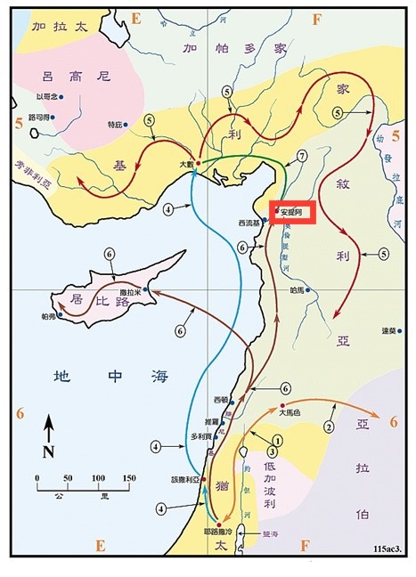

Slide 17
徒11：29于是门徒定意，照各人的力量捐钱，送去供给住在犹太的弟兄。30他们就这样行，把捐项托巴拿巴和扫罗，送到众长老那里。 Acts11:29The disciples, as each one was able, decided to provide help for the brothers and sisters living in Judea. 30This they did, sending their gift to the elders by Barnabas and Saul.

Slide 18
徒11：25他又往大数去找扫罗，26找着了，就带他到安提阿去。他们足有一年的工夫，和教会一同聚集，教训了许多人。门徒称为基督徒，是从安提阿起首。 Acts11:25 Then Barnabas went to Tarsus to look for Saul, 26and when he found him, he brought him to Antioch. So for a whole year Barnabas and Saul met with the church and taught great numbers of people. The disciples were called Christians first at Antioch.

Slide 19
总结 Summary
一、突破你生命中的界限——安提阿教会的建立
二、突破生命界限的例子——神的仆人巴拿巴
三、突破生命界限的成果——安提阿教会的见证。

